Slide 1
Maximum Subarray Sum using Divide and Conquer
Efficient Solution to the Maximum Subarray Sum Problem
Presented by Rajkumar Das

Slide 2
Problem: Maximum Subarray Sum
Given an array of integers (including positive and negative), find the contiguous subarray with the largest sum.
Example: [3, -7, 5, -2, 8, -9, 4, 1, 6, -3]
Best subarray: [5, -2, 8, -9, 4, 1, 6] → Maximum sum = 13

Slide 3
Four ways to solve this problem with decreasing time complexity
Brute Force
Improved Brute Force
Kadane’s Algorithm using Dynamic Programming
Time: O(n³)
Check every possible subarray and compute each sum from scratch.
Time: O(n²)
Reuse partial sums so each subarray does not need to be recomputed fully.
Time: O(n)
Track the best sum ending at each position and decide whether to extend or restart.
Divide and Conquer
Time: O(nlogn)
Divide the array into two halves, solve each half recursively, and find the best subarray crossing the middle.

Slide 4

Brute Force Method (O(n³))
Idea: Enumerate every contiguous subarray and compute its sum from scratch.
maxSum = -∞
for i = 0 to n−1
for j = i to n−1
sum = 0
for k = i to j
sum += arr[k]
maxSum = max(maxSum, sum)
Complexity: Outer O(n) × Middle O(n) × Inner O(n) = O(n³)
This method repeats many identical summations — inefficient and impractical for large n.

Slide 5
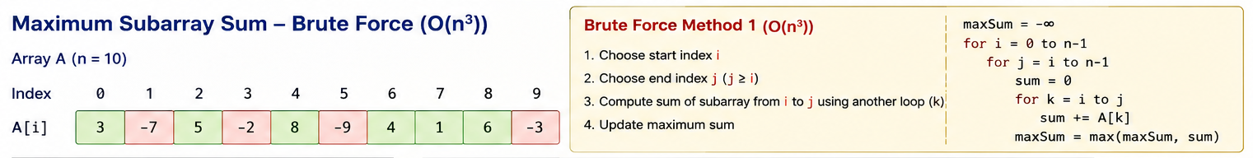

Slide 6
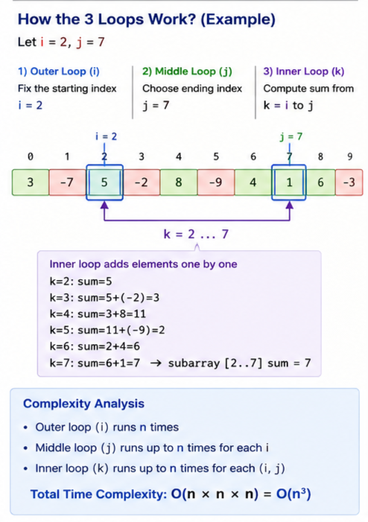

Slide 7
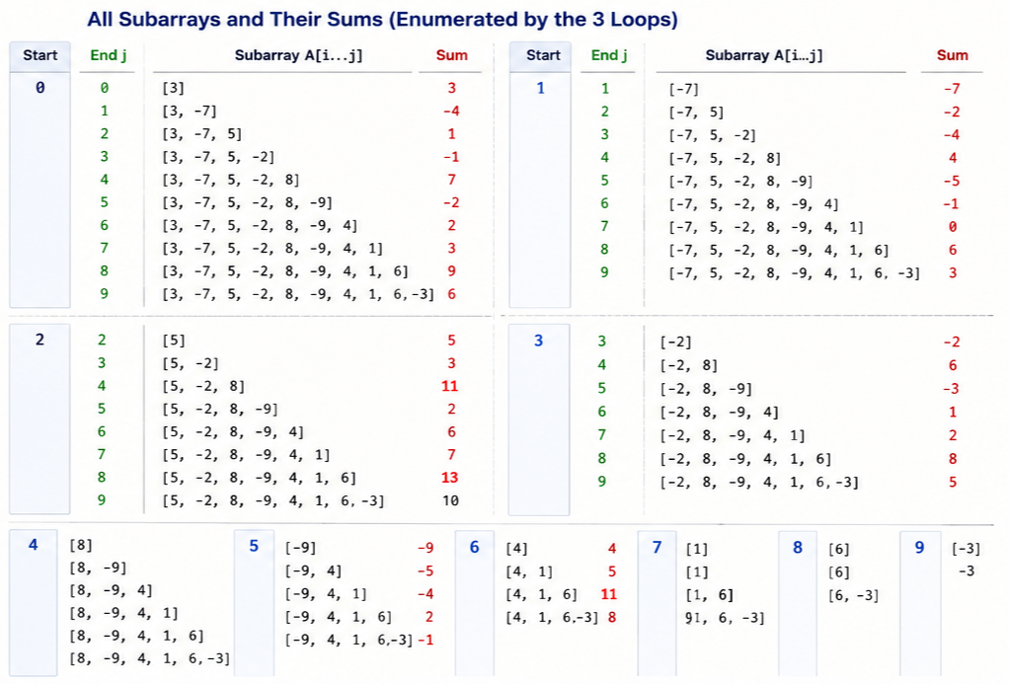

Slide 8
Improved Brute Force (O(n²))
Observation: Reuse a running sum instead of recomputing it for each j.
maxSum = -∞
for i = 0 to n−1
sum = 0
for j = i to n−1
sum += arr[j]
maxSum = max(maxSum, sum)
Complexity: O(n²). Eliminates the inner-most loop by carrying forward partial sums.
Still examines every starting index i — can we do better?

Slide 10
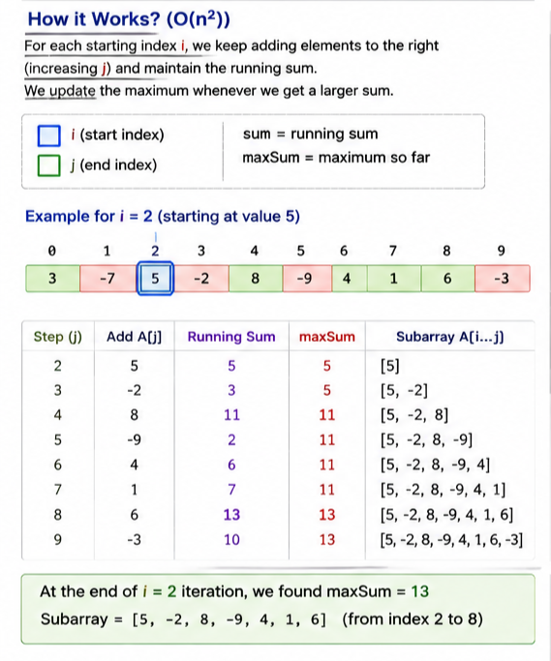

Slide 11
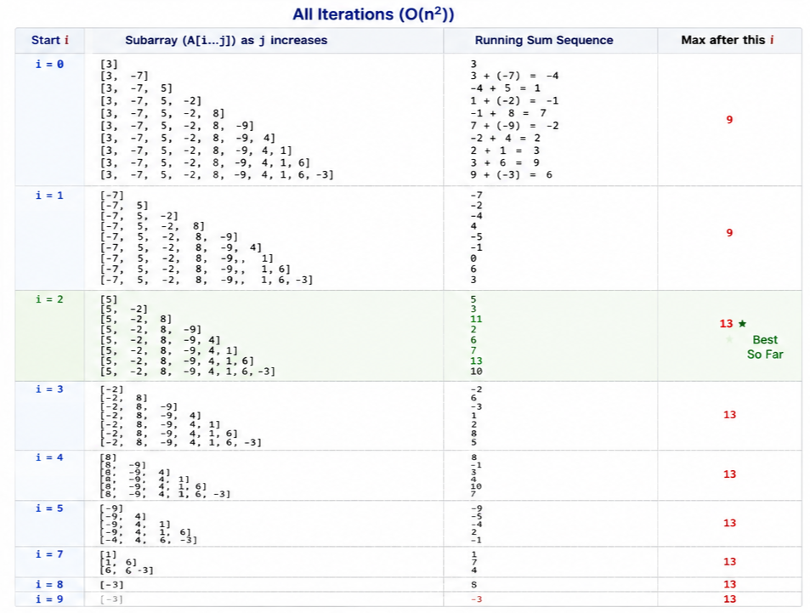

Slide 12
Divide and Conquer Method (O(nlogn))
Idea: Divide the array into two halves and recursively find the maximum subarray in each half.
MaxSubarray(arr, left, right):
if left == right:
return arr[left]
mid = (left + right) // 2
leftMax = MaxSubarray(arr, left, mid)
rightMax = MaxSubarray(arr, mid + 1, right)
crossMax = MaxCrossingSum(arr, left, mid, right)
return max(leftMax, rightMax, crossMax)
MaxCrossingSum(arr, left, mid, right):
find maximum sum from mid → left
find maximum sum from mid+1 → right
return leftSum + rightSum
The array is divided into two halves recursively, and finding the crossing sum takes O(n)

Slide 13
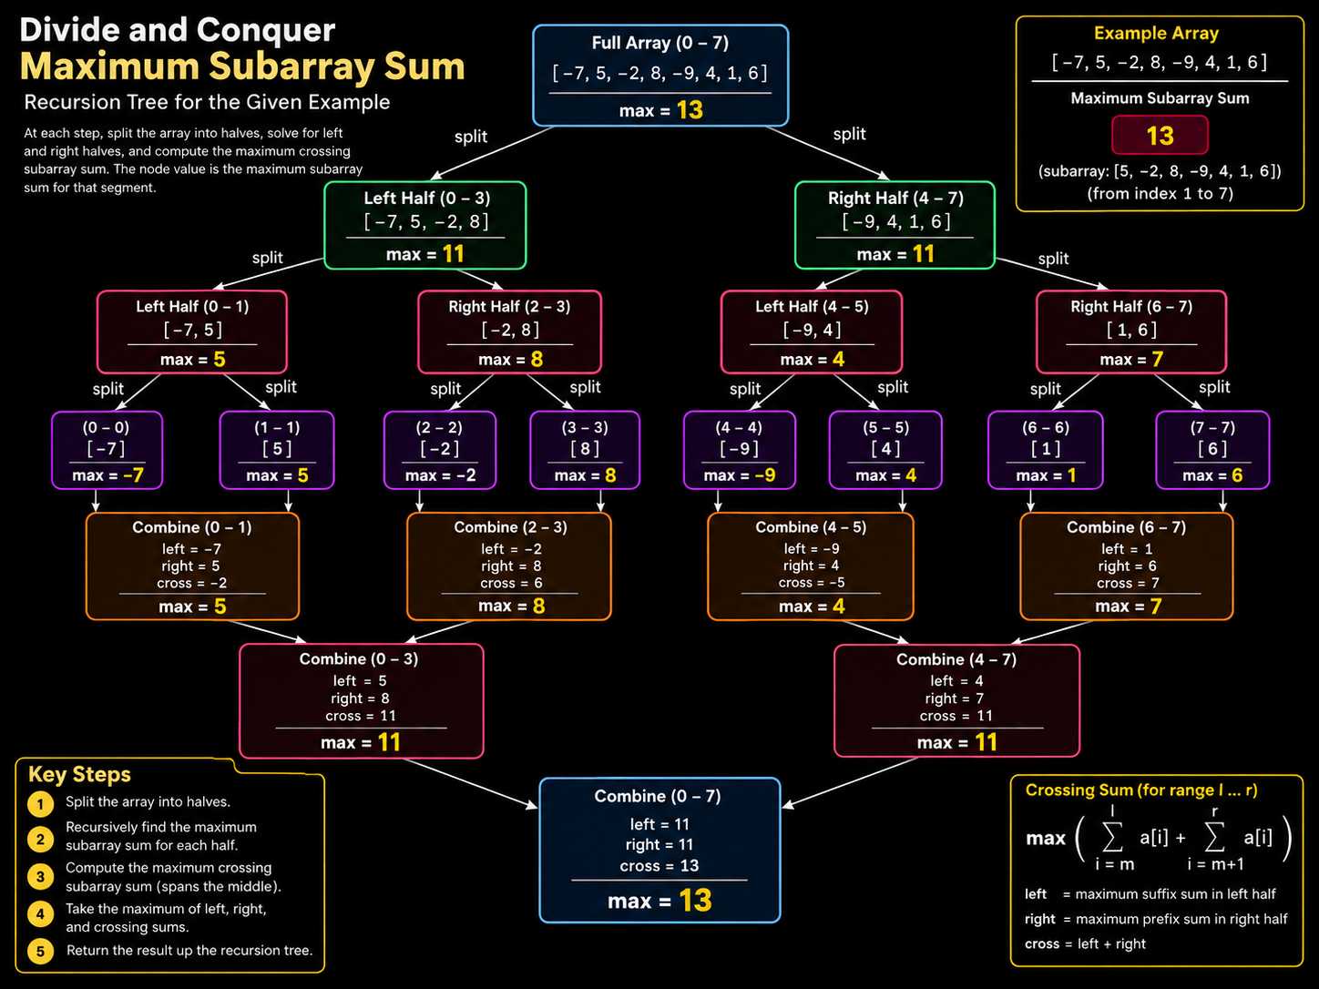

Slide 14
3
-7
5
-2
8
-9
4
1
6
-3
3
-7
5
-2
8
-9
4
1
6
-3
-4
3
-1
5
3
3
5
8
5
6
3
-7
5
-2
8
-9
4
1
6
-3
1
4
8
6
5
3
-7
5
-2
8
-9
4
1
6
-3
11
11
6
3
-7
5
-2
8
-9
4
1
6
-3
13
13
3
-7
5
-2
8
-9
4
1
6
-3

Slide 15
-42
-27
45
-8
73
-56
19
-34
91
-12
-67
38
-3
82
24
-42
-27
45
-8
73
-56
19
-34
91
-12
-67
38
-3
82
24
-69
37
17
-15
79
-29
79
-27
45
73
19
91
38
82
24
-42
-27
45
-8
73
-56
19
-34
91
-12
-67
38
-3
82
24
18
36
50
106
45
73
91
106
-42
-27
45
-8
73
-56
19
-34
91
-12
-67
38
-3
82
24
110
153
110
153
-42
-27
45
-8
73
-56
19
-34
91
-12
-67
38
-3
82
24
192
192
-42
-27
45
-8
73
-56
19
-34
91
-12
-67
38
-3
82
24

Slide 16
3
7
5
2
8
-9
-4
-1
-6
-3
3
7
5
2
8
-9
-4
-1
-6
-3
10
7
-1
-5
-9
10
7
8
-1
-3
3
7
5
2
8
-9
-4
-1
-6
-3
17
7
8
-3
17
3
7
5
2
8
-9
-4
-1
-6
-3
25
25
-3
3
7
5
2
8
-9
-4
-1
-6
-3
22
25
3
7
5
2
8
-9
-4
-1
-6
-3

Slide 17
Kadane's Algorithm (Space-Optimized DP)
Observation: dp[i] needs only dp[i−1]. Store two variables instead of an array.
currentSum = arr[0]
maxSum = arr[0]
for i = 1 to n−1
currentSum = max(arr[i], currentSum + arr[i])
maxSum = max(maxSum, currentSum)
return maxSum
Complexity: Time O(n), Space O(1)
Kadane converts the DP recurrence into an elegant single-pass algorithm.

Slide 18
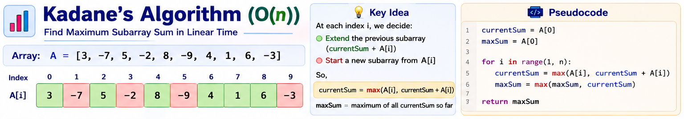

Slide 19
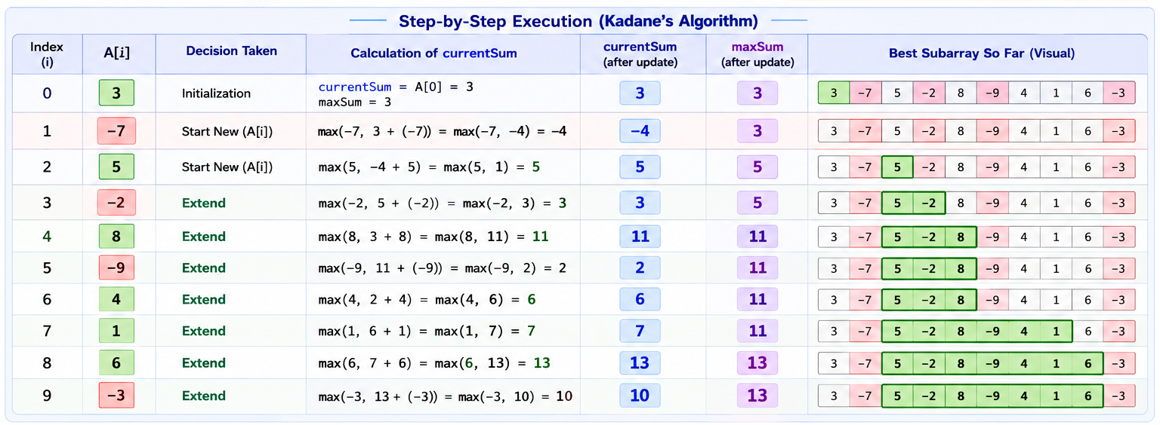

Slide 20
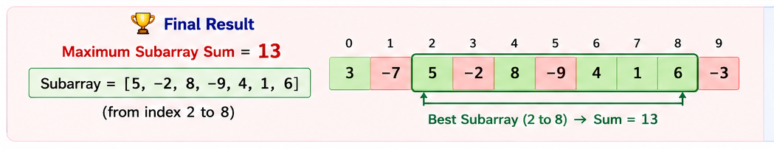

Slide 21
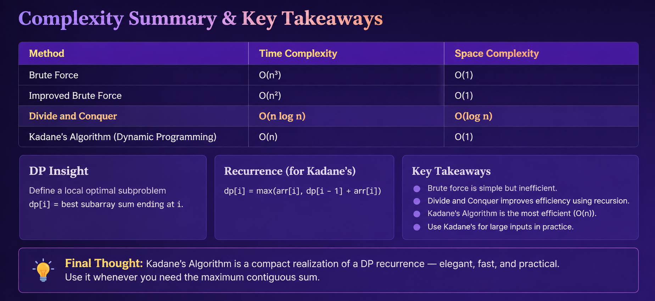
Complexity Summary
Method
Time
Space
Brute Force
O(n³)
O(1)
Improved Brute Force
O(n²)
O(1)
Kadane's Algorithm
O(n)
O(1)

Slide 22
References
https://www.geeksforgeeks.org/dsa/maximum-subarray-sum-using-divide-and-conquer-algorithm/
https://personal.utdallas.edu/~daescu/maxsa.pdf
https://www.geeksforgeeks.org/dsa/largest-sum-contiguous-subarray/
https://www.geeksforgeeks.org/cpp/maximum-subarray-sum-in-cpp/

Slide 23
Thank You

